Slide 1



Raising local oral health awareness
Communication
strategies to engage
your community
and promote KOHA
A presentation by Matt Jacob to local health
leaders in California u October 22, 2019

Slide 2
My objectives
Demonstrate the importance of using plain language to promote KOHA
Show ways to present oral health data that enhance the public’s ability to understand why KOHA matters
Offer suggestions for proactive ways to engage the public to raise awareness of KOHA and oral health
Recommend strategies for using social media to complement your other communication activities

Slide 3
Using plain language
to promote KOHA
and oral health

Slide 4
U.S. adult literacy levels
80
70
60
50
40
30
20
10
0
71.4 M
65.1 M
Millions of U.S. adults
26.5 M
26.6 M
16.6 M
Very low or Low literacy Mid-level Moderate High levels
unable to skills literacy to high
measure
(Source: “Adult Literacy in the United States,” DataPoint, U.S. Department of Education, July 2019; researchers used the Program for the International Assessment of Adult Competencies’ (PIACC) testing methodology, with adults between the ages of 18 and 65.)

Slide 5
U.S. adult literacy levels
80
70
60
50
40
30
20
10
0
108 million adults
71.4 M
65.1 M
Millions of U.S. adults
26.5 M
26.6 M
16.6 M
Very low or Low literacy Mid-level Moderate High levels
unable to skills literacy to high
measure
(Source: “Adult Literacy in the United States,” DataPoint, U.S. Department of Education, July 2019; researchers used the Program for the International Assessment of Adult Competencies’ (PIACC) testing methodology, with adults between the ages of 18 and 65.)

Slide 6
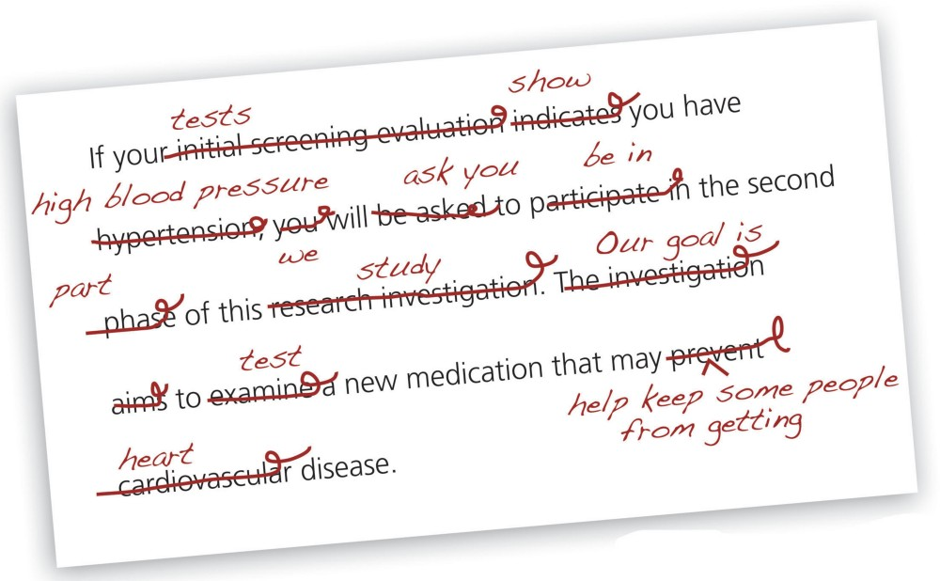
Avoid clinical and technical terms
Write and talk to the public using plain language
(Source: Jessica Ridpath, “Got plain language? 5 tips for clear, engaging writing — even in research,” Group Health Research Institute, posted on Medium.com, Oct. 17, 2016)

Slide 7

Don’t assume your terms are understood
Many terms commonly used by the public health community may not be understood or may be misunderstood by the public:
Health outcomes
Surveillance data
Dental utilization

Slide 8
Write clearly and concisely
Clarity means shorter sentences (under 25 words)
(Sources: Everyday Words for Public Health Communication, CDC, May 2016; Cornelia Dean, Am I Making Myself Clear? A Scientist’s Guide to Talking to the Public, Harvard Univ. Press: Cambridge, Mass., 2009; A Way with Words: Guidelines for Writing Oral Health Materials for Audiences with Limited Literacy, National Maternal and Child Oral Health Resource Center, 2004.)

Slide 9
Write clearly and concisely
Clarity means shorter sentences (under 25 words)
Clarity means shorter paragraphs (under 100 words)
(Sources: Everyday Words for Public Health Communication, CDC, May 2016; Cornelia Dean, Am I Making Myself Clear? A Scientist’s Guide to Talking to the Public, Harvard Univ. Press: Cambridge, Mass., 2009; A Way with Words: Guidelines for Writing Oral Health Materials for Audiences with Limited Literacy, National Maternal and Child Oral Health Resource Center, 2004.)

Slide 10
Write clearly and concisely
Clarity means shorter sentences (under 25 words)
Clarity means shorter paragraphs (under 100 words)
Clarity means deleting “lazy words” — words that take up space but aren’t necessary for understanding
(Sources: Everyday Words for Public Health Communication, CDC, May 2016; Cornelia Dean, Am I Making Myself Clear? A Scientist’s Guide to Talking to the Public, Harvard Univ. Press: Cambridge, Mass., 2009; A Way with Words: Guidelines for Writing Oral Health Materials for Audiences with Limited Literacy, National Maternal and Child Oral Health Resource Center, 2004.)

Slide 11

Write clearly and concisely
Clarity means shorter sentences (under 25 words)
Clarity means shorter paragraphs (under 100 words)
Clarity means deleting “lazy words” — words that take up space but aren’t necessary for understanding
In the future, we want to ensure that every family that happens to live in a low-income community in Anytown is truly able to have access to both foods and beverages that are healthy and nutritious.
(Sources: Everyday Words for Public Health Communication, CDC, May 2016; Cornelia Dean, Am I Making Myself Clear? A Scientist’s Guide to Talking to the Public, Harvard Univ. Press: Cambridge, Mass., 2009; A Way with Words: Guidelines for Writing Oral Health Materials for Audiences with Limited Literacy, National Maternal and Child Oral Health Resource Center, 2004.)

Slide 12
Write clearly and concisely
Clarity means shorter sentences (under 25 words)
Clarity means shorter paragraphs (under 100 words)
Clarity means deleting “lazy words” — words that take up space but aren’t necessary for understanding
In the future, we want to ensure that every family that happens to live in a low-income community in Anytown is truly able to have access to both foods and beverages that are healthy and nutritious.
(Sources: Everyday Words for Public Health Communication, CDC, May 2016; Cornelia Dean, Am I Making Myself Clear? A Scientist’s Guide to Talking to the Public, Harvard Univ. Press: Cambridge, Mass., 2009; A Way with Words: Guidelines for Writing Oral Health Materials for Audiences with Limited Literacy, National Maternal and Child Oral Health Resource Center, 2004.)

Slide 13
Write clearly and concisely
Clarity means shorter sentences (under 20 words)
Clarity means shorter paragraphs (under 100 words)
Clarity means deleting “lazy words” — words that take up space but aren’t necessary for understanding
We want every low-income family in Anytown to have access to healthy foods and drinks.
(Sources: Everyday Words for Public Health Communication, CDC, May 2016; Cornelia Dean, Am I Making Myself Clear? A Scientist’s Guide to Talking to the Public, Harvard Univ. Press: Cambridge, Mass., 2009; A Way with Words: Guidelines for Writing Oral Health Materials for Audiences with Limited Literacy, National Maternal and Child Oral Health Resource Center, 2004.)

Slide 14

Write clearly and concisely
Clarity means shorter sentences (under 20 words)
Clarity means shorter paragraphs (under 100 words)
Clarity means deleting “lazy words” — words that take up space but aren’t necessary for understanding
Clarity means using subheads or other icons help to guide the reader
(Sources: Everyday Words for Public Health Communication, CDC, May 2016; Cornelia Dean, Am I Making Myself Clear? A Scientist’s Guide to Talking to the Public, Harvard Univ. Press: Cambridge, Mass., 2009; A Way with Words: Guidelines for Writing Oral Health Materials for Audiences with Limited Literacy, National Maternal and Child Oral Health Resource Center, 2004.)

Slide 15
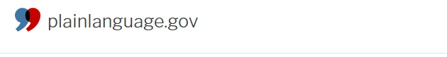
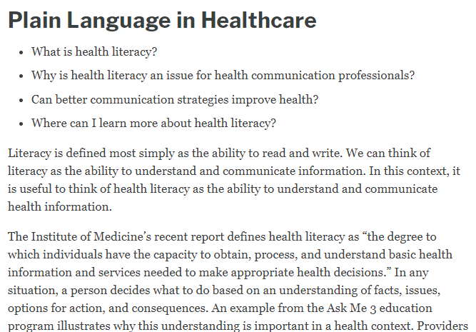
Good resources for plain language

Slide 16
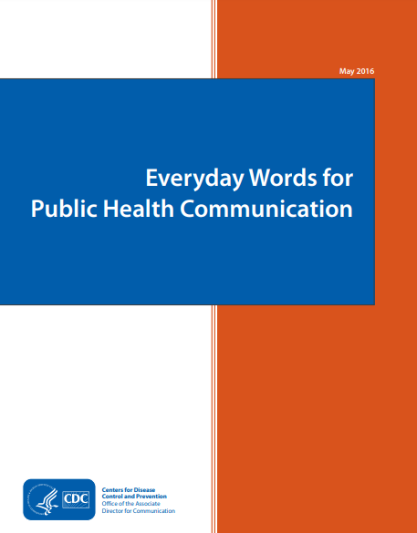
Good resources for plain language

Slide 17
Maximizing
the impact
of your data

Slide 18

Making your data count
Be strategic. Don’t engage in a data dump.
Less is more.
Choose the data that you feel will make the biggest impact on parents and the public.

Slide 19

Making your data count
Think twice before inserting bar graphs, charts or other data visuals in your reports or media materials.
Ask yourself: Will it make sense to them or can we share this in a simpler form?

Slide 20

Making your data count
Consider using ratios instead of percentages. Citing 19% of children doesn’t sound impressive, but citing 1 in 5 kids can put it in a helpful perspective.

Slide 21
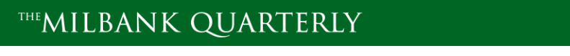
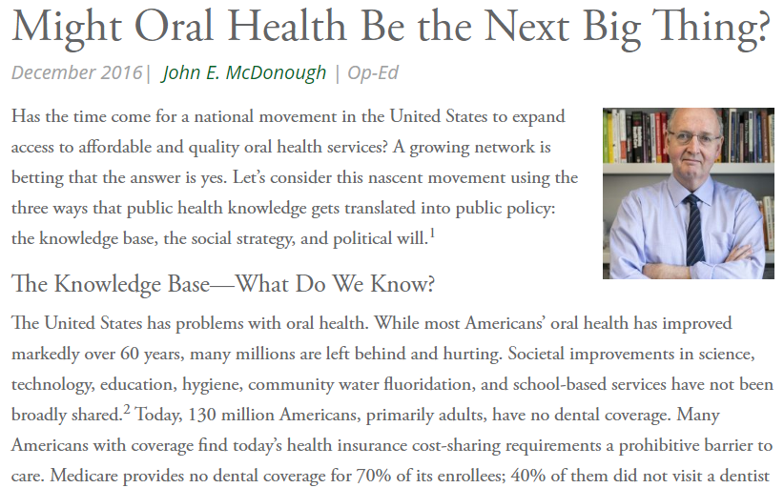
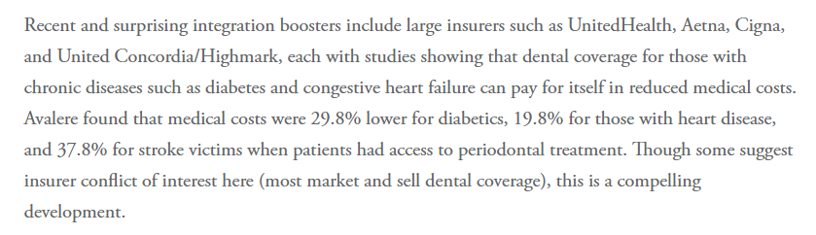
Simplify your data
Use whole numbers unless there is a special reason for decimal points

Slide 22
Taking proactive
steps to engage
your community

Slide 23

Raising awareness, inspiring action
Giving talks or presentations to key stakeholders is essential to raise awareness of KOHA and get stakeholders to view it as a priority.

Slide 24

Use the KOHA slide template
Use the template of slides that has been circulated to promote KOHA.
On Slide 21, feel free to add a few local organizations that are active supporters of KOHA.
Slide 25 can be customized to include one or more “asks”.

Slide 25

Use the KOHA talking points
Talking points have been provided to promote KOHA.
These talking points are primarily aimed at encouraging the education community to make KOHA a priority. Feel
free to tailor them for other audiences.

Slide 26

Working with your partners
Write an article about KOHA for their blog or newsletter
Offer to conduct a workshop at their next conference or meeting
Share infographics or other interesting visuals
Encourage them to write an op-ed column about KOHA and submit it to a local publication

Slide 27

Working with your partners
Thank them privately and publicly for their collaboration

Slide 28


Raise KOHA’s profile at health fairs

Slide 29

Raise KOHA’s profile at health fairs

Slide 30

Raise KOHA’s profile at health fairs

Slide 31

Raise KOHA’s profile at health fairs

Slide 32
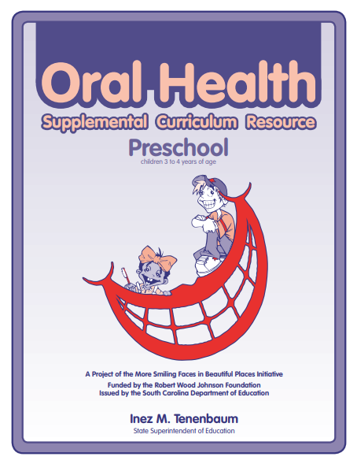
Engage educators and children
Reach out to local preschools and Head Start programs
Encourage them to make children and parents aware of KOHA and mention the assessment within the context of oral health-related learning activities

Slide 33
Using social media
to raise community
awareness

Slide 34

Why social media matters
Social media is a low-cost way to reach stakeholders who normally wouldn’t see or hear your messages.
Include hashtags in your messages that help you break out of your silo
Develop social media messages well ahead of time so they can be submitted and approved

Slide 35

Why social media matters
Ask key partners to use their social media accounts to promote KOHA and your broader oral health efforts
Co-host a Twitter chat about KOHA or another oral health-related issue (example: sugary drinks)
xx
Create a Social Media Message Kit with sample messages that people can use to raise oral health awareness

Slide 36
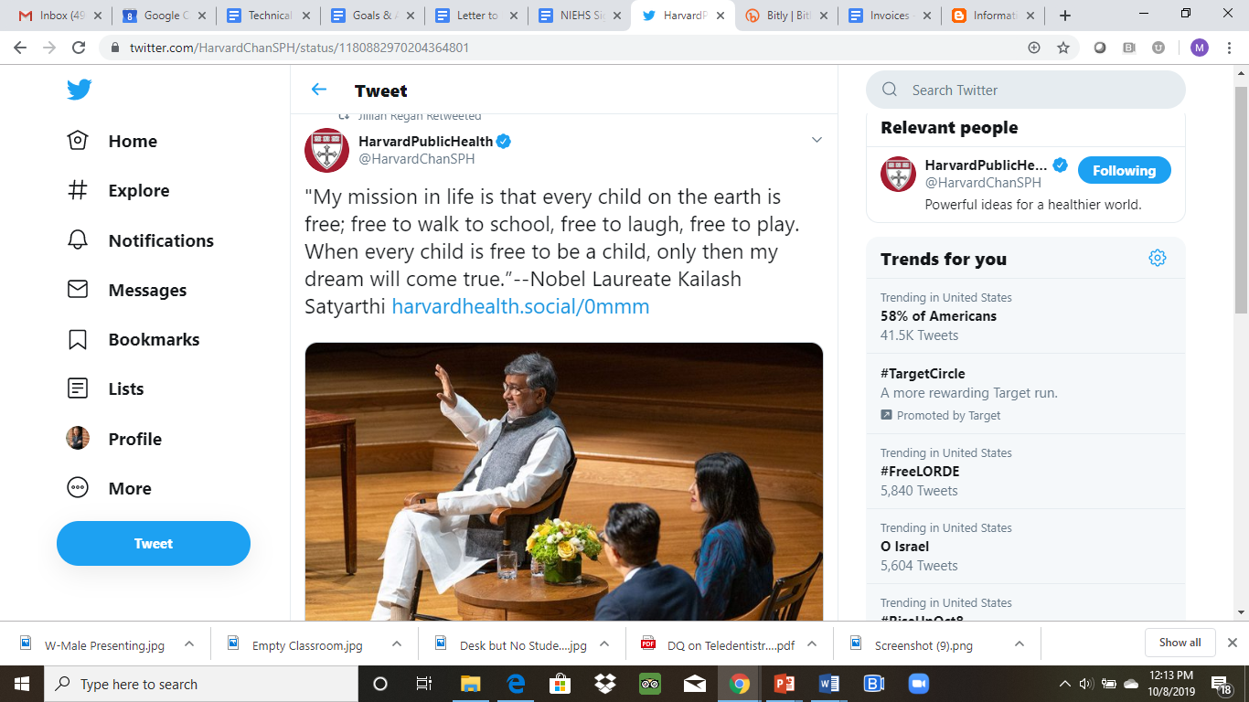
Be aspirational

Slide 37
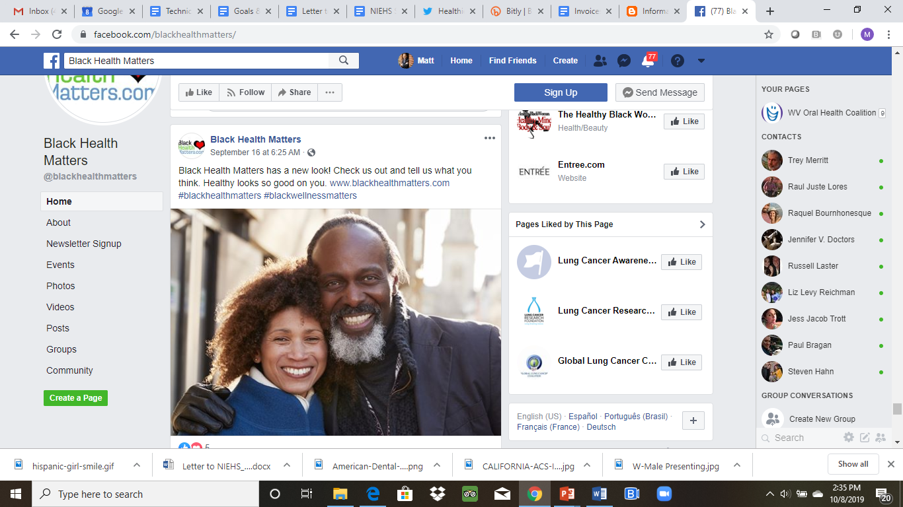
Be aspirational

Slide 38
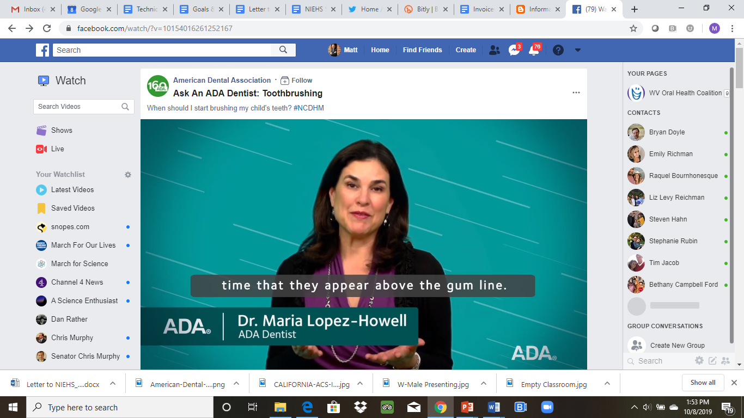
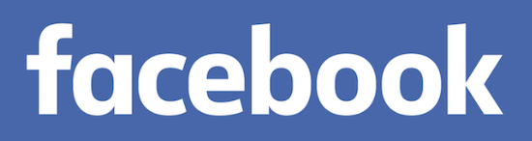
Offer tips and tools

Slide 39
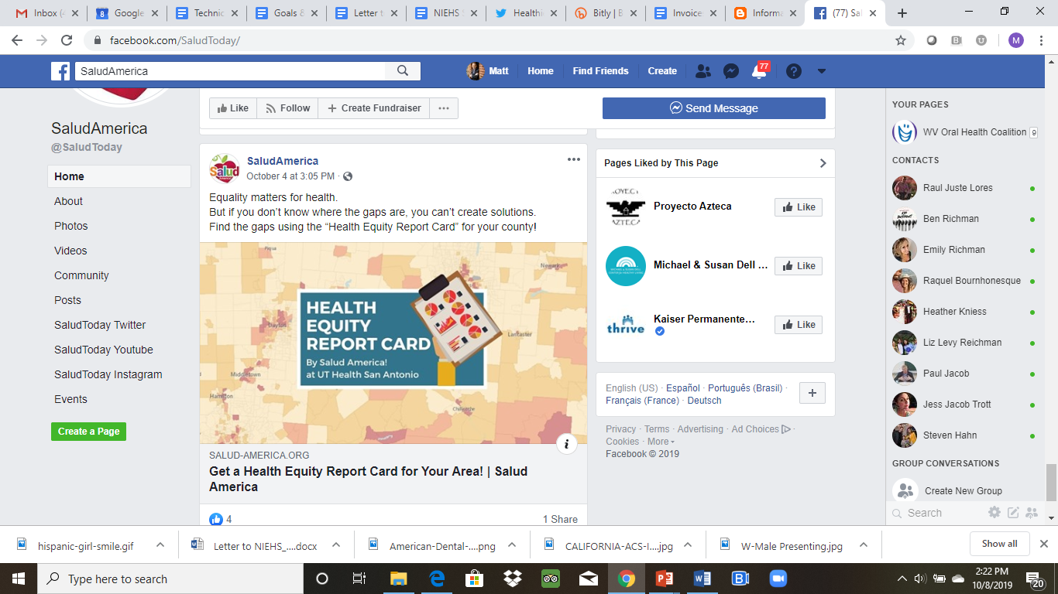
Offer tips and tools

Slide 40
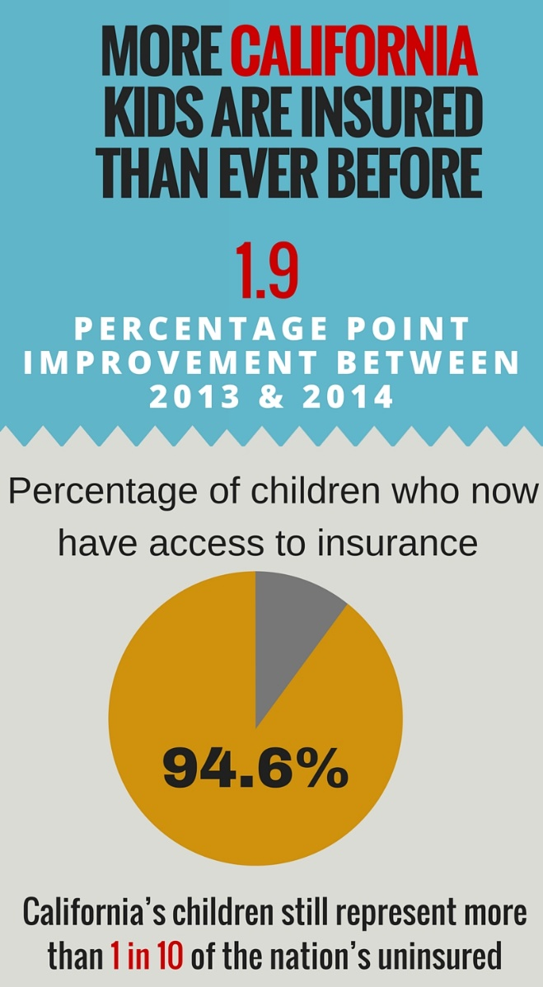
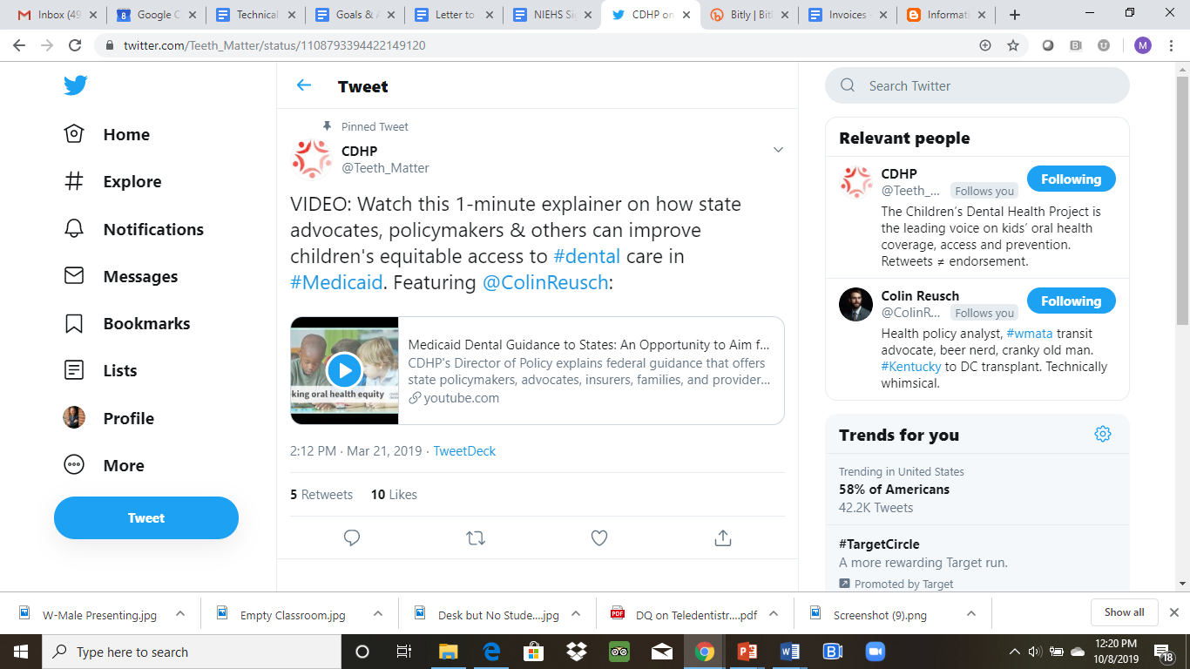
Share videos and graphics

Slide 41

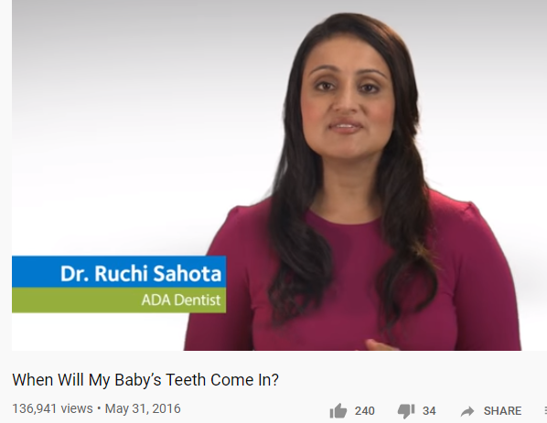
Where to find videos and graphics
Visit YouTube and look for consumer-focused videos from these and other stakeholders:
American Dental Association
Delta Dental*
SciShow Kids
* Not Delta Dental Insurance Co.

Slide 42

Visuals matter
When looking for visuals to use with your social media or fact sheets, avoid photos/graphics that cast dental care in a negative light.

Slide 43
Hashtags: Help them find you
Hashtags can be used on Twitter, Facebook, Instagram or LinkedIn
Be strategic: What hashtag is most likely to reach the audience you want to reach?
#Dental
#OralHealth
#ChildHealth
#EarlyChildhood
#Kindergarten
#WomensHealth
#LatinxHealth
#SchoolReadiness
#HealthyAging
#HealthLiteracy
#Prevention
#Diabetes
#Obesity
#LittleKidsBigCADreams
#Tweetatrician
#CultureOfHealth
#HealthEquity
#HealthDisparities
#Poverty
#PublicHealth
#Education
#HealthyEating
#CALeg
#Medicaid
#CAParent
#EastBayParents

Slide 44
Hashtags: Help them find you
Hashtags can be used on Twitter, Facebook, Instagram or LinkedIn
Be strategic: What hashtag is most likely to reach the audience you want to reach?
#Dental
#OralHealth
#ChildHealth
#EarlyChildhood
#Kindergarten
#WomensHealth
#LatinxHealth
#SchoolReadiness
#HealthyAging
#HealthLiteracy
#Prevention
#Diabetes
#Obesity
#LittleKidsBigCADreams
#Tweetatrician
#CultureOfHealth
#HealthEquity
#HealthDisparities
#Poverty
#PublicHealth
#Education
#HealthyEating
#CALeg
#Medicaid
#CAParent
#EastBayParents

Slide 45
Hashtags: Help them find you
Hashtags can be used on Twitter, Facebook, Instagram or LinkedIn
Be strategic: What hashtag is most likely to reach the audience you want to reach?
#Dental
#OralHealth
#ChildHealth
#EarlyChildhood
#Kindergarten
#WomensHealth
#LatinxHealth
#SchoolReadiness
#HealthyAging
#HealthLiteracy
#Prevention
#Diabetes
#Obesity
#LittleKidsBigCADreams
#Tweetatrician
#CultureOfHealth
#HealthEquity
#HealthDisparities
#Poverty
#PublicHealth
#Education
#HealthyEating
#CALeg
#Medicaid
#CAParent
#EastBayParents

Slide 46
Hashtags: Help them find you
Hashtags can be used on Twitter, Facebook, Instagram or LinkedIn
Be strategic: What hashtag is most likely to reach the audience you want to reach?
#Dental
#OralHealth
#ChildHealth
#EarlyChildhood
#Kindergarten
#WomensHealth
#LatinxHealth
#SchoolReadiness
#HealthyAging
#HealthLiteracy
#Prevention
#Diabetes
#Obesity
#LittleKidsBigCADreams
#Tweetatrician
#CultureOfHealth
#HealthEquity
#HealthDisparities
#Poverty
#PublicHealth
#Education
#HealthyEating
#CALeg
#Medicaid
#CAParent
#EastBayParents

Slide 47
Hashtags: Help them find you
Hashtags can be used on Twitter, Facebook, Instagram or LinkedIn
Be strategic: What hashtag is most likely to reach the audience you want to reach?
#Dental
#OralHealth
#ChildHealth
#EarlyChildhood
#Kindergarten
#WomensHealth
#LatinxHealth
#SchoolReadiness
#HealthyAging
#HealthLiteracy
#Prevention
#Diabetes
#Obesity
#LittleKidsBigCADreams
#Tweetatrician
#CultureOfHealth
#HealthEquity
#HealthDisparities
#Poverty
#PublicHealth
#Education
#HealthyEating
#CALeg
#Medicaid
#CAParent
#EastBayParents

Slide 48

Consider using a customized hashtag
A customized hashtag can be used on Twitter, Facebook, or Instagram to monitor social media related to your efforts to promote KOHA.
Use this hashtag (example: #KOHA 4 Fresno) when you co-host or participate in a social media chat or storm.

Slide 49

Who to follow? Some examples:
California’s Surgeon General @DrBurkeHarris 26,600
First 5 California* @First5CA 19,600
Children Now @Children Now 8,800
CA Dept of Public Health @CAPublicHealth 16,200
Children’s Partnership @KidsPartnership 5,000
CA Pan-Ethnic Health Network @CPEHN 4,500
Asian American Research @ARCHDrNguyen 1,900
Center on Health
CA Healthcare Foundation @CHCFNews 10,300
California Healthline @CalHealthline 9,800
(NOTE: This is not intended as an endorsement of any organization. The organizations are listed as examples of stakeholders in the health sector that could be followed on social media.)

Slide 50

Calendar events = great opportunities
Use social media to promote KOHA and oral health during:
Children’s Dental Health Month (February)
National Nutrition Month (March)
National Public Health Week (April)
National Minority Health Month (April)
Every Kid Healthy Week (last week in April)
National Women’s Health Week (May)
# Back To School messages (Early to Mid-August)
National Childhood Obesity Awareness Month (September)

Slide 51

Community bulletin boards & blogs
Think beyond Facebook and Twitter
Consider community bulletin boards and parents’ blogs
Ask a local partner to post messages that promote KOHA

Slide 52
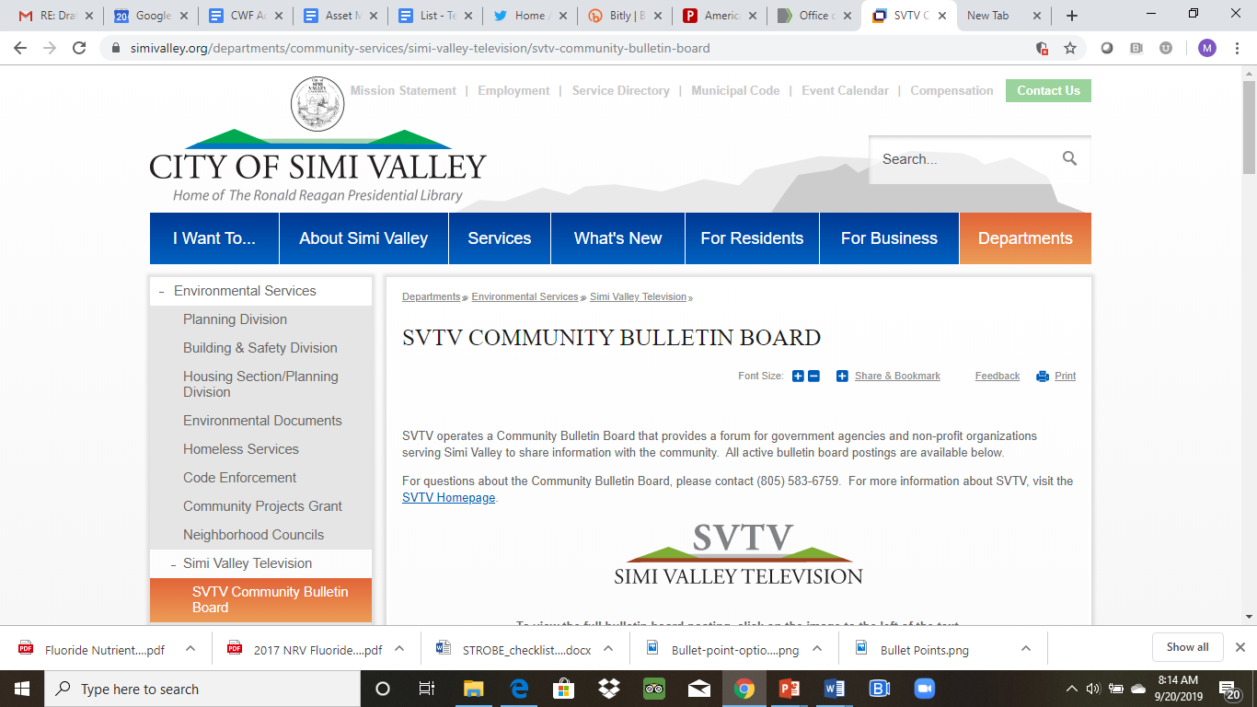
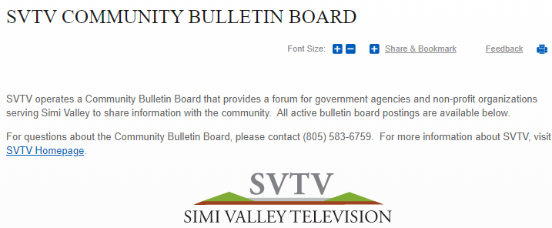
Community bulletin boards
Post info about KOHA for parents in your community

Slide 53

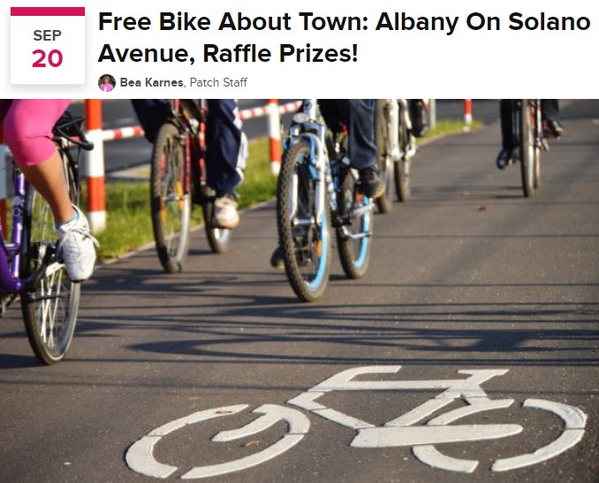
Community bulletin boards
Post info about KOHA for parents in your community

Slide 54
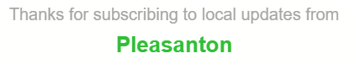
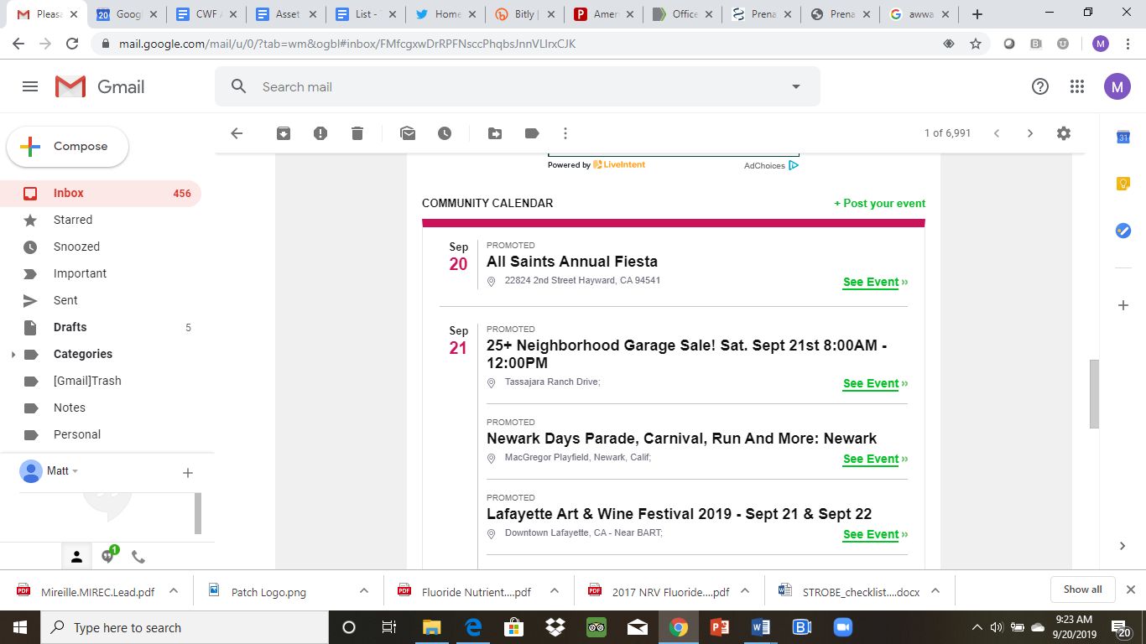
Community bulletin boards

Slide 55
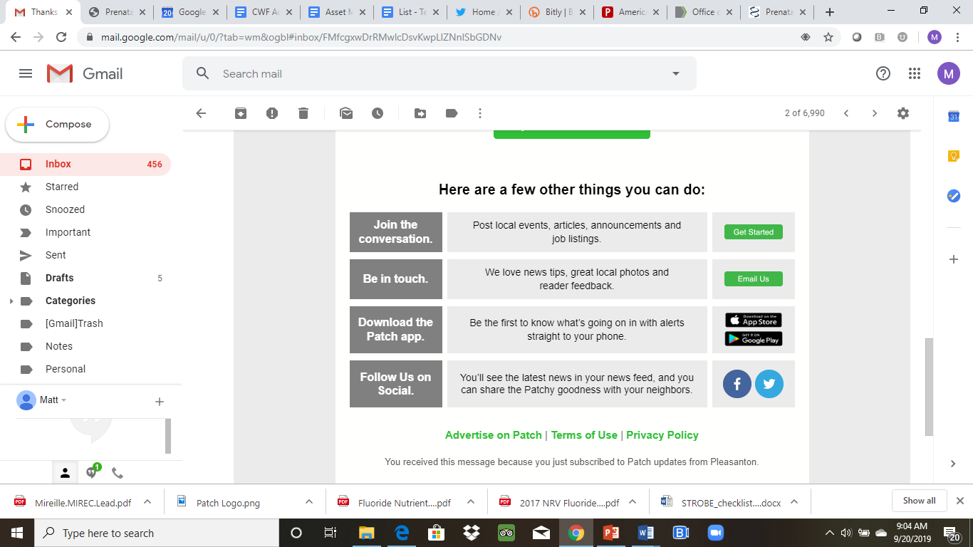
Community bulletin boards

Slide 56
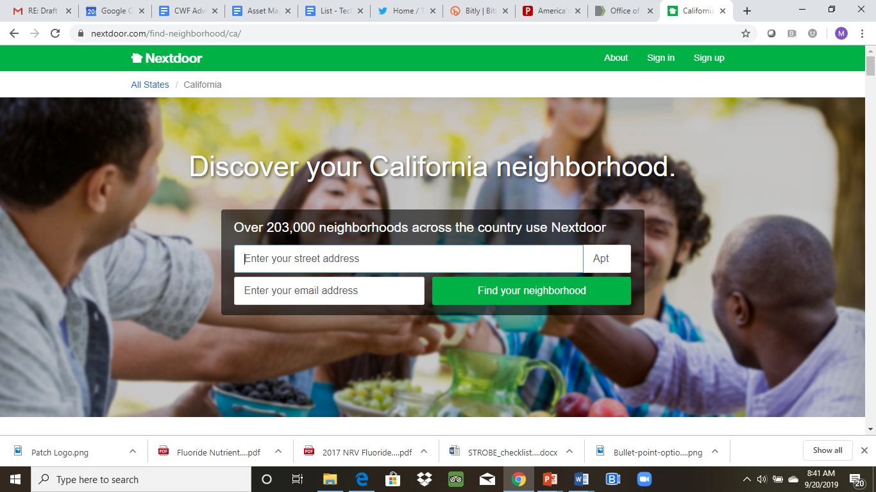
Community bulletin boards

Slide 57

Matt Jacob
E: mattlivesindc@gmail.com W: jacobstrategies.com
Twitter: @Matt in DC tweets
Questions?
Comments?

